Slide 1
Earned Value Management System (EVMS)

Slide 2
Life without Earned Value
Given:
  total budget of $100,000
  12 month effort
  produce 20 units
Status:
  spent to date: $64,000
  time elapsed: 6 months
  units produced: 8 complete, 2 partial
How are you doing, and how do you know how you are doing?
How far along are you?

Slide 3

What’s the Project Status?
10 Computers to upgrade
1,000 man-hours budget
4 weeks to complete (i.e, 250 man-hrs/week)
End of wk. 2. Have used 600 man-hours.
How’s the Project?

Slide 4
What’s the Project Status?
10 Computers to upgrade
1,000 man-hours
4 weeks to complete (i.e, 250 man-hrs/week)
End of wk. 2 Have used 600 man-hours and.....
4 installed in 1st two wks.
How’s the Project?
What’s the % complete? 4 units/10 units = 40% or 2 wk/4 wk. = 50% or 600hr/1000hr = 60%
Earned value is a great way to summarize the work completed in “Dollarized” terms.
Especially useful on multi-task projects

Slide 5



Why do we need early warning
Course corrections are easier when you have time to make small adjustments
It’s too late when you’re this close to the iceberg!

Slide 6
The process
An integrated baseline plan is established
  work is defined, scheduled, and resources are allocated
Work and resources are driven down to lowest level for execution
A work authorization system (e.g. charging) is set up that controls changes to the baseline
Budgets are “earned” as work is completed = EARNED VALUE
Status provided against baseline
  schedule and cost variances are isolated
Problem assistance
  early warning
  corrective plans
Early insight provided into final estimated cost

Slide 7
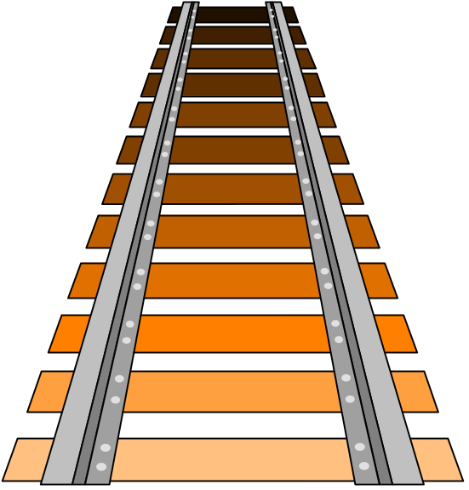
EVMS measures progress
Progress = Movement Forward
to measure progress,
there must be a standard
against which the forward
movement may be compared
EVMS establishes a baseline
to measure progress

Slide 8
What do we measure against
Performance measurement baseline
  budget that is spread over . . .
  time, to accomplish the scope of
  work
  and against which progress can be measured
Earned Value is key concept
  how much progress did I make against my original plan?
  expressed in dollars or hours
baseline
$
earned value

Slide 9
Basic Terms
BCWS | Budgeted Cost of Cork Scheduled
BCWP | Budgeted Cost of work performed
ACWP | Actual Cost of Work Performed
BAC | Budget At Completion
EAC | Estimate At Completion

Slide 10

Total Budget
It’s my pleasure to award you this contract for a new railroad
track
hmm...5 miles of track, 5 months to do it all....$5000 budget....This
is going to be tough!
What is the total job supposed to cost?
What is the value of the contract at cost?

Slide 11
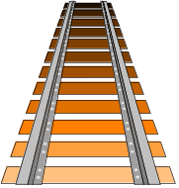

Budgeted Cost of Work Scheduled
(BCWS)
Total Budget = $5,000
to be spent over 5 months
I plan to lay 1 section
of track each month at an
estimated cost of $1,000.
BCWS each month = $1,000
Month 1
BCWS = $1,000
Month 2
BCWS = $1,000
Month 3
BCWS = $1,000
Month 4
BCWS = $1,000
Month 5
BCWS = $1,000
each dollar of BCWS represents a specific dollar of work scope

Slide 12
Budgeted Cost of Work Scheduled
(BCWS)
Total Budget = $5,000
Total BCWS = $5,000
Month 1
BCWS = $1,000
Month 2
BCWS = $1,000
Month 3
BCWS = $1,000
Month 4
BCWS = $1,000
Month 5
BCWS = $1,000
BCWS is aggregated and summed as the performance measurement baseline

Slide 13

Budgeted Cost of Work Performed
(BCWP)
the EARNED VALUE concept
We’re at the end of the
second month, but only
1 section of track is
complete. Value of
work performed = $1,000
You earn value the same way
as it was budgeted in baseline

Slide 14
Schedule variance (SV)
Difference between work scheduled and work performed expressed in terms of budget $
SV($) = BCWP – BCWS
e.g. SV = $1000 - $2000
SV = -$1000 (negative = behind schedule)
Note: SV is Budget Based

Slide 15
Budget At Completion (BAC)
$5,000
$
time
when all work has been phased, cumulative BCWS = BAC
e.g., $5,000 = $5,000

Slide 16

Actual Cost of Work Performed
(ACWP)
Labor came to $1,300,
and materials cost
$1,100. That first section
of track cost $2,400!
actual expenditures vs. budget

Slide 17
Cost Variance (CV)
Difference between budgeted cost and actual Cost
CV($) = BCWP – ACWP
e.g. CV = $1000 - $2000
CV = -$1000 (negative = Over budget)
Note: CV is performance based

Slide 18
Variances
 | = 0 | <0 | >0
SV = (BCWP – BCWS) | On schedule | Poor performance | Good performance
CV = (BCWP – ACWP) | On budget | Poor performance | Good performance

Slide 19
Earned Value Exercise 1
A 15 week project has been initiated. The budget for the project is $460,000. Here is the data for 3 weeks of the project. The scheduled work was 21 days, it has taken 23 days.
Week
BCWS
BCWP
ACWP
1
$35K
$31K
$26K
2
$25K
$24K
$18K
3
$30K
$25K
$23K

Slide 20

Estimate at Completion (EAC)
We should be able to complete the job ….uh… for about $7500

Slide 21
Variance at Completion (VAC)
B AC what the total job is supposed
to cost
E AC what the total job is expected
to cost
VARIANCE AT COMPLETION is the difference between what the total job is supposed to cost and what the total job is now expected to cost.
FORMULA: VAC = BAC - EAC
Example: VAC = $5,000 - $7,500
VAC = - $2,500 (negative = overrun)

Slide 22
Basic performance data
QUESTION ANSWER ACRONYM
How much work should Budgeted Cost for BCWS
be done? Work Scheduled
How much work is done? Budgeted Cost for BCWP
Work Performed
How much did the “is done” Actual Cost of ACWP
work cost? Work Performed
What was the total job Budget at Completion BAC
supposed to cost?
What do we now expect the Estimate at Completion EAC
total job to cost?

Slide 23
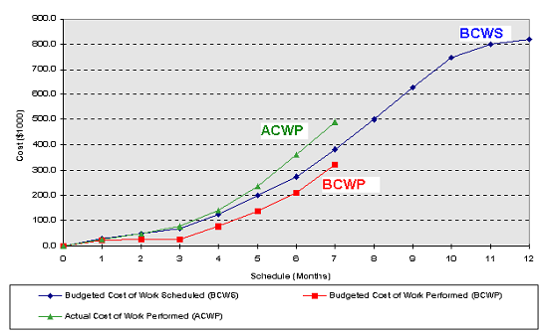
EVMS - Plot

Slide 24
Cost & Schedule variances
5,000
BCWS
ACWP
$
cv
sv
BCWP
TIME
5 months
schedule variance = BCWP - BCWS = negative number
cost variance = BCWP - ACWP = negative number
behind schedule,
over cost

Slide 25
CPI and SPI
CPI is the the ratio of budgeted, or baseline, costs of work performed to actual costs of work performed
SPI is the ratio of work performed to work scheduled. SPI is often used to estimate the project completion date.

Slide 26
Performance Indices
 | = 1 | <1 | >1
SPI = (BCWP/BCWS) | On schedule | Poor performance | Good performance
CPI = (BCWP/ACWP) | On budget | Poor performance | Good performance

Slide 27
Earned Value Exercise 1
A 15 week project has been initiated. The budget for the project is $460,000. Here is the data for 3 weeks of the project. The scheduled work was 21 days, it has taken 23 days.
Week
BCWS
BCWP
ACWP
1
$35K
$31K
$26K
2
$25K
$24K
$18K
3
$30K
$25K
$23K

Slide 28
Forecasting
BAC: Budget At Completion
ETC: Estimate to Complete
  = (BAC-BCWP)
EAC: Estimate at Completion
  = BAC/CPI

Slide 29
Other Derived Values
To Complete Performance Index (TCPI)
  TCPI = (BAC - BCWP)/(BAC - ACWP)
  Denotes the amount of performance required for the remaining work of the project in order to get the project back on track if things don’t change
Should be kept as close as possible to 1.00

Slide 30
Other Derived Values
Variance at Completion (VAC)
  VAC = (BAC - EAC)
  Denotes the amount over or under what was budgeted for the project
Work Accomplished (%)
  BCWP/BAC
Budget Spent (%)
  ACWP/BAC

Slide 31
Earned Value Exercise 1
A 15 week project has been initiated. The budget for the project is $460,000. Here is the data for 3 weeks of the project. The scheduled work was 21 days, it has taken 23 days.
Week
BCWS
BCWP
ACWP
1
$35K
$31K
$26K
2
$25K
$24K
$18K
3
$30K
$25K
$23K

Slide 32

Variance Analysis Questions
What is the problem causing the
  variance?
What is the impact on time, cost, & performance
What is the impact on other efforts, if any?
What corrective action is planned or under way?
What are the expected results of the corrective action?

